Slide 1
Spelling Correction and the Noisy Channel
The Spelling Correction Task

Slide 2
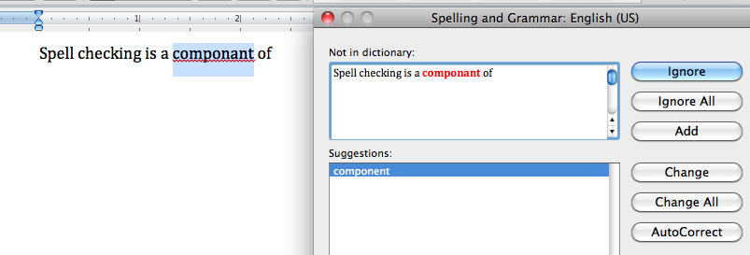
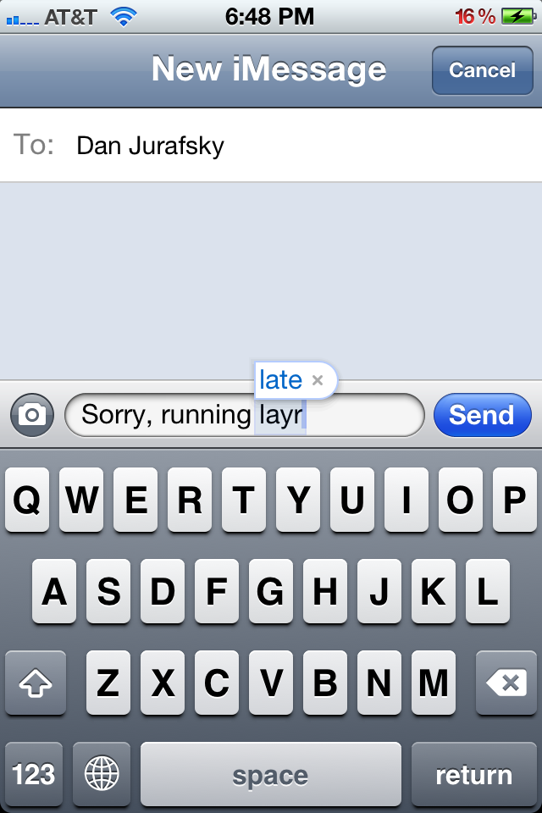
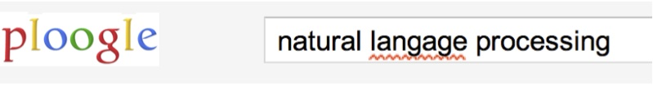
Applications for spelling correction
Word processing
Phones
Web search

Slide 3
Spelling Tasks
Spelling Error Detection
Spelling Error Correction:
  Autocorrect
    hte→the
  Suggest a correction
  Suggestion lists

Slide 4
Types of spelling errors
Non-word Errors
  graffe →giraffe
Real-word Errors
  Typographical errors
    three →there
  Cognitive Errors (homophones)
    piece→peace,
    too → two

Slide 5
Rates of spelling errors
  26%: Web queries Wang et al. 2003
  13%: Retyping, no backspace: Whitelaw et al. English&German
  7%: Words corrected retyping on phone-sized organizer
  2%: Words uncorrected on organizer Soukoreff &MacKenzie 2003
1-2%: Retyping: Kane and Wobbrock 2007, Gruden et al. 1983

Slide 6
Non-word spelling errors
Non-word spelling error detection:
  Any word not in a dictionary is an error
  The larger the dictionary the better
Non-word spelling error correction:
  Generate candidates: real words that are similar to error
  Choose the one which is best:
    Shortest weighted edit distance
    Highest noisy channel probability

Slide 7
Real word spelling errors
For each word w, generate candidate set:
  Find candidate words with similar pronunciations
  Find candidate words with similar spelling
  Include w in candidate set
Choose best candidate
  Noisy Channel
  Classifier

Slide 8
Spelling Correction and the Noisy Channel
The Spelling Correction Task

Slide 9
Spelling Correction and the Noisy Channel
The Noisy Channel Model of Spelling

Slide 10
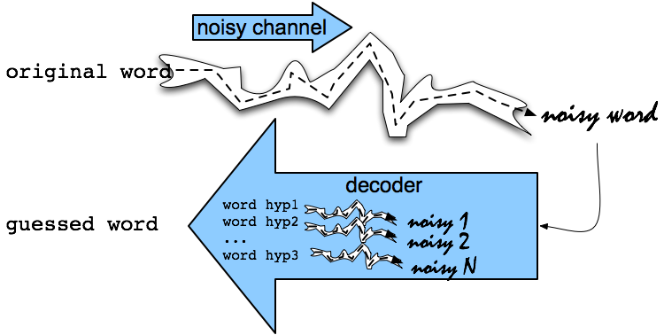
Noisy Channel Intuition

Slide 11
Noisy Channel
We see an observation x of a misspelled word
Find the correct word w
Notes:
Bayes Rule

Slide 12
History: Noisy channel for spelling proposed around 1990
IBM
  Mays, Eric, Fred J. Damerau and Robert L. Mercer. 1991. Context based spelling correction. Information Processing and Management, 23(5), 517–522
AT&T Bell Labs
  Kernighan, Mark D., Kenneth W. Church, and William A. Gale. 1990. A spelling correction program based on a noisy channel model. Proceedings of COLING 1990, 205-210

Slide 13
Non-word spelling error example
acress

Slide 14
Candidate generation
Words with similar spelling
  Small edit distance to error
Words with similar pronunciation
  Small edit distance of pronunciation to error

Slide 15
Damerau-Levenshtein edit distance
Minimal edit distance between two strings, where edits are:
  Insertion
  Deletion
  Substitution
  Transposition of two adjacent letters

Slide 16
Words within 1 of acress
Error | Candidate Correction | Correct Letter | Error Letter | Type
acress | actress | t | - | deletion
acress | cress | - | a | insertion
acress | caress | ca | ac | transposition
acress | access | c | r | substitution
acress | across | o | e | substitution
acress | acres | - | s | insertion
acress | acres | - | s | insertion

Slide 17
Candidate generation
80% of errors are within edit distance 1
Almost all errors within edit distance 2
Also allow insertion of space or hyphen
  thisidea → this idea
  inlaw → in-law

Slide 18
Language Model
Use any of the language modeling algorithms we’ve learned
Unigram, bigram, trigram
Web-scale spelling correction
  Stupid backoff

Slide 19
Unigram Prior probability
Counts from 404,253,213 words in Corpus of Contemporary English (COCA)
word | Frequency of word | P(word)
actress | 9,321 | .0000230573
cress | 220 | .0000005442
caress | 686 | .0000016969
access | 37,038 | .0000916207
across | 120,844 | .0002989314
acres | 12,874 | .0000318463

Slide 20
Channel model probability
Error model probability, Edit probability
Kernighan, Church, Gale 1990
Misspelled word x = x₁, x₂, x₃… x_{m}
Correct word w = w₁, w₂, w₃,…, w_{n}
P(x|w) = probability of the edit
  (deletion/insertion/substitution/transposition)

Slide 21
Computing error probability: confusion matrix
del[x,y]: count(xy typed as x)
ins[x,y]: count(x typed as xy)
sub[x,y]: count(x typed as y)
trans[x,y]: count(xy typed as yx)
Insertion and deletion conditioned on previous character

Slide 22
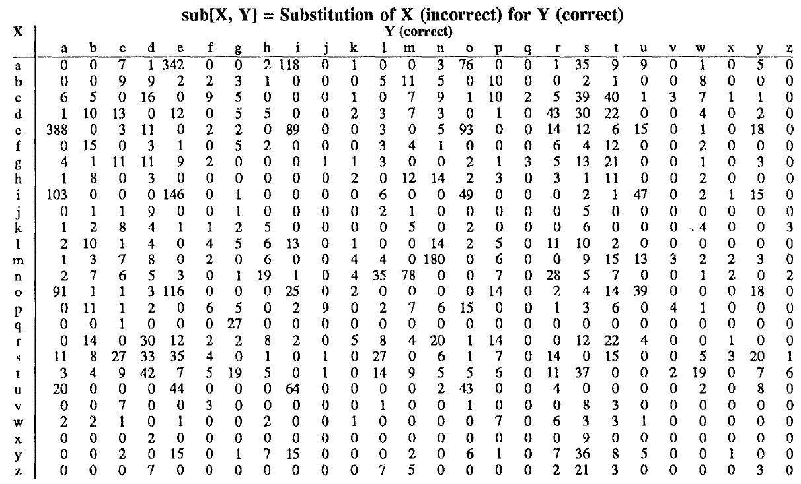
Confusion matrix for spelling errors

Slide 23
Generating the confusion matrix
Peter Norvig’s list of errors
Peter Norvig’s list of counts of single-edit errors

Slide 24
Channel model
Kernighan, Church, Gale 1990

Slide 25
Channel model for acress
Candidate Correction | Correct Letter | Error Letter | x|w | P(x|word)
actress | t | - | c|ct | .000117
cress | - | a | a|# | .00000144
caress | ca | ac | ac|ca | .00000164
access | c | r | r|c | .000000209
across | o | e | e|o | .0000093
acres | - | s | es|e | .0000321
acres | - | s | ss|s | .0000342

Slide 26
Noisy channel probability for acress
Candidate Correction | Correct Letter | Error Letter | x|w | P(x|word) | P(word) | 10^{9 *}P(x|w)P(w)
actress | t | - | c|ct | .000117 | .0000231 | 2.7
cress | - | a | a|# | .00000144 | .000000544 | .00078
caress | ca | ac | ac|ca | .00000164 | .00000170 | .0028
access | c | r | r|c | .000000209 | .0000916 | .019
across | o | e | e|o | .0000093 | .000299 | 2.8
acres | - | s | es|e | .0000321 | .0000318 | 1.0
acres | - | s | ss|s | .0000342 | .0000318 | 1.0

Slide 27
Noisy channel probability for acress
Candidate Correction | Correct Letter | Error Letter | x|w | P(x|word) | P(word) | 10^{9 *}P(x|w)P(w)
actress | t | - | c|ct | .000117 | .0000231 | 2.7
cress | - | a | a|# | .00000144 | .000000544 | .00078
caress | ca | ac | ac|ca | .00000164 | .00000170 | .0028
access | c | r | r|c | .000000209 | .0000916 | .019
across | o | e | e|o | .0000093 | .000299 | 2.8
acres | - | s | es|e | .0000321 | .0000318 | 1.0
acres | - | s | ss|s | .0000342 | .0000318 | 1.0

Slide 28
Using a bigram language model
“a stellar and versatile acress whose combination of sass and glamour…”
Counts from the Corpus of Contemporary American English with add-1 smoothing
P(actress|versatile)=.000021 P(whose|actress) = .0010
P(across|versatile) =.000021 P(whose|across) = .000006
P(“versatile actress whose”) = .000021*.0010 = 210 x10⁻¹⁰
P(“versatile across whose”) = .000021*.000006 = 1 x10⁻¹⁰

Slide 29
Using a bigram language model
“a stellar and versatile acress whose combination of sass and glamour…”
Counts from the Corpus of Contemporary American English with add-1 smoothing
P(actress|versatile)=.000021 P(whose|actress) = .0010
P(across|versatile) =.000021 P(whose|across) = .000006
P(“versatile actress whose”) = .000021*.0010 = 210 x10⁻¹⁰
P(“versatile across whose”) = .000021*.000006 = 1 x10⁻¹⁰

Slide 30
Evaluation
Some spelling error test sets
  Wikipedia’s list of common English misspelling
  Aspell filtered version of that list
  Birkbeck spelling error corpus
  Peter Norvig’s list of errors (includes Wikipedia and Birkbeck, for training or testing)

Slide 31
Spelling Correction and the Noisy Channel
The Noisy Channel Model of Spelling

Slide 32
Spelling Correction and the Noisy Channel
Real-Word Spelling Correction

Slide 33
Real-word spelling errors
…leaving in about fifteen minuets to go to her house.
The design an construction of the system…
Can they lave him my messages?
The study was conducted mainly be John Black.
25-40% of spelling errors are real words Kukich 1992

Slide 34
Solving real-world spelling errors
For each word in sentence
  Generate candidate set
    the word itself
    all single-letter edits that are English words
    words that are homophones
Choose best candidates
    Noisy channel model
    Task-specific classifier

Slide 35
Noisy channel for real-word spell correction
Given a sentence w₁,w₂,w₃,…,w_{n}
Generate a set of candidates for each word w_{i}
  Candidate(w₁) = {w₁, w’₁ , w’’₁ , w’’’₁ ,…}
  Candidate(w₂) = {w₂, w’₂ , w’’₂ , w’’’₂ ,…}
  Candidate(w_{n}) = {w_{n}, w’_{n} , w’’_{n} , w’’’_{n} ,…}
Choose the sequence W that maximizes P(W)

Slide 36
Noisy channel for real-word spell correction

Slide 37
Noisy channel for real-word spell correction

Slide 38
Simplification: One error per sentence
Out of all possible sentences with one word replaced
  w₁, w’’₂,w₃,w₄ two off thew
  w₁,w₂,w’₃,w₄ two of the
  w’’’₁,w₂,w₃,w₄ too of thew
  …
Choose the sequence W that maximizes P(W)

Slide 39
Where to get the probabilities
Language model
  Unigram
  Bigram
  Etc
Channel model
  Same as for non-word spelling correction
  Plus need probability for no error, P(w|w)

Slide 40
Probability of no error
What is the channel probability for a correctly typed word?
P(“the”|“the”)
Obviously this depends on the application
  .90 (1 error in 10 words)
  .95 (1 error in 20 words)
  .99 (1 error in 100 words)
  .995 (1 error in 200 words)

Slide 41
Peter Norvig’s “thew” example
x | w | x|w | P(x|w) | P(w) | 10⁹ P(x|w)P(w)
thew | the | ew|e | 0.000007 | 0.02 | 144
thew | thew |  | 0.95 | 0.00000009 | 90
thew | thaw | e|a | 0.001 | 0.0000007 | 0.7
thew | threw | h|hr | 0.000008 | 0.000004 | 0.03
thew | thwe | ew|we | 0.000003 | 0.00000004 | 0.0001

Slide 42
Spelling Correction and the Noisy Channel
Real-Word Spelling Correction

Slide 43
Spelling Correction and the Noisy Channel
State-of-the-art Systems

Slide 44
HCI issues in spelling
If very confident in correction
  Autocorrect
Less confident
  Give the best correction
Less confident
  Give a correction list
Unconfident
  Just flag as an error

Slide 45
State of the art noisy channel
We never just multiply the prior and the error model
Independence assumptions→probabilities not commensurate
Instead: Weigh them
Learn λ from a development test set

Slide 46
Phonetic error model
Metaphone, used in GNU aspell
  Convert misspelling to metaphone pronunciation
    “Drop duplicate adjacent letters, except for C.”
    “If the word begins with 'KN', 'GN', 'PN', 'AE', 'WR', drop the first letter.”
    “Drop 'B' if after 'M' and if it is at the end of the word”
    …
  Find words whose pronunciation is 1-2 edit distance from misspelling’s
  Score result list
    Weighted edit distance of candidate to misspelling
    Edit distance of candidate pronunciation to misspelling pronunciation

Slide 47
Improvements to channel model
Allow richer edits (Brill and Moore 2000)
  ent→ant
  ph→f
  le→al
Incorporate pronunciation into channel (Toutanova and Moore 2002)

Slide 48
Channel model
Factors that could influence p(misspelling|word)
  The source letter
  The target letter
  Surrounding letters
  The position in the word
  Nearby keys on the keyboard
  Homology on the keyboard
  Pronunciations
  Likely morpheme transformations

Slide 49
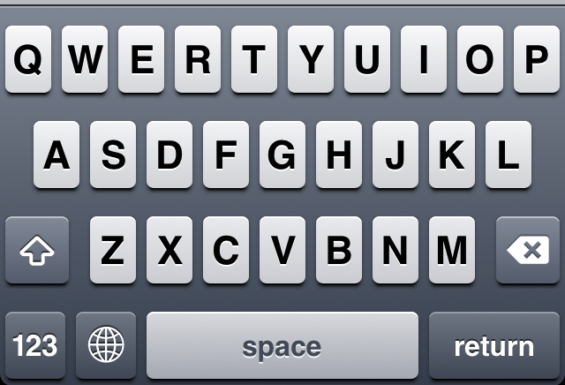
Nearby keys

Slide 50
Classifier-based methods for real-word spelling correction
Instead of just channel model and language model
Use many features in a classifier (next lecture).
Build a classifier for a specific pair like:
whether/weather
    “cloudy” within +- 10 words
    ___ to VERB
    ___ or not

Slide 51
Spelling Correction and the Noisy Channel
Real-Word Spelling Correction

